Slide 1





Content mining of the biomedical literature
Peter Murray-Rust,
Yusuf Hamied Dept of Chemistry, University of Cambridge,
with Shweata N Hegde, Ayush Garg, Prachi Singh, Anuv Chakraborty, Rageshwari Singh
InCoB, 2021-11-07

Slide 2
Schedule
Content mining: PeterM-R
Applications
Tools
Wikidata
examples
Mining with dictionaries Shweata Hegde / Prachi Singh / Rageshwari Singh. (Video)
Downloading with pygetpapers Ayush Garg (Video)
Image mining PeterM-R
Image mining with pyamiimage Anuv Chakraborty (Video)
Conclusions and opportunities Peter M-R
Tools include: py/getpapers, pyami/image, ami3, Python3, nltk, sci/spaCy, skimage, sknw, matplotlib
Repositories: EuropePMC, github
Services: Wikidata
All software, documents, data are Open

Slide 3
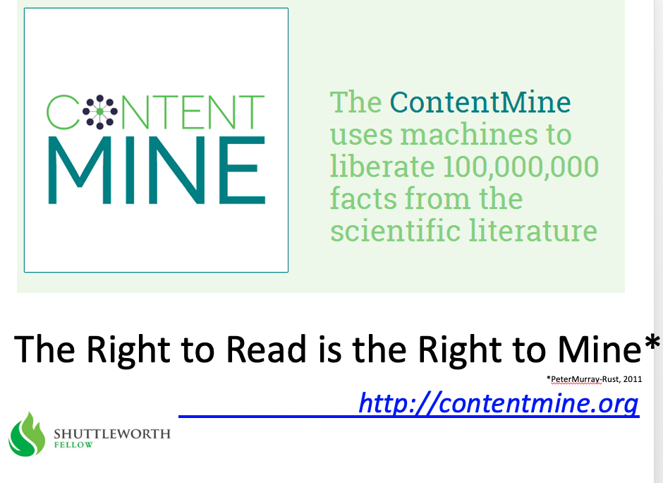
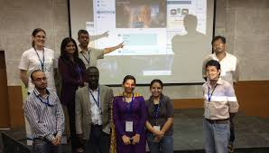
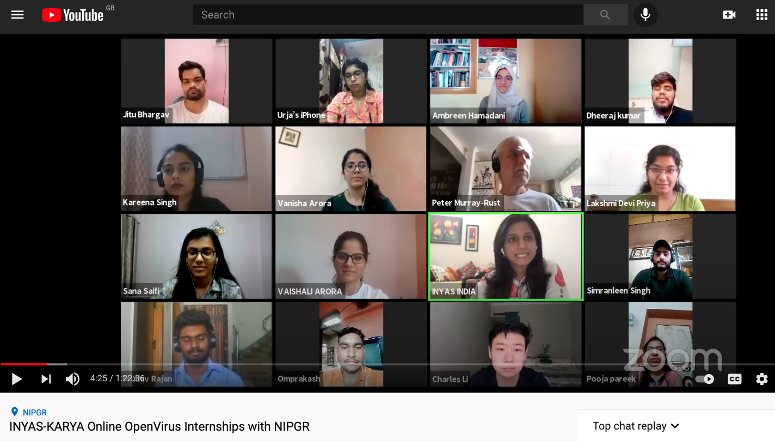
2013
TIGR2ESS 2019 Delhi Food Security FEB 2019
Gita Yadav + colleagues
Delhi 2014
NIPGR: Developed Virtually over 6 weeks!
OpenVirus
Priya and Kareena interns
JUNE 2020
INYAS – KARYA-DBT
CEVOpen 2021
https://www.youtube.com/watch?v=XiTngk-POm8&ab_channel=INYASYouTube
Aug 2020
2020-06-01

Slide 4
How we work
Open Notebook Science *
- Everything uploaded to Github immediately
Agile teams (daily report, teams take tasks)
We teach and support each other
Workshops and interns and volunteers
TIGR2ESS (Cambridge-India)
KARYA (DST Rajasthan)
INYAS
NIPGR
* Thanks to Jean-Claude Bradley

Slide 6

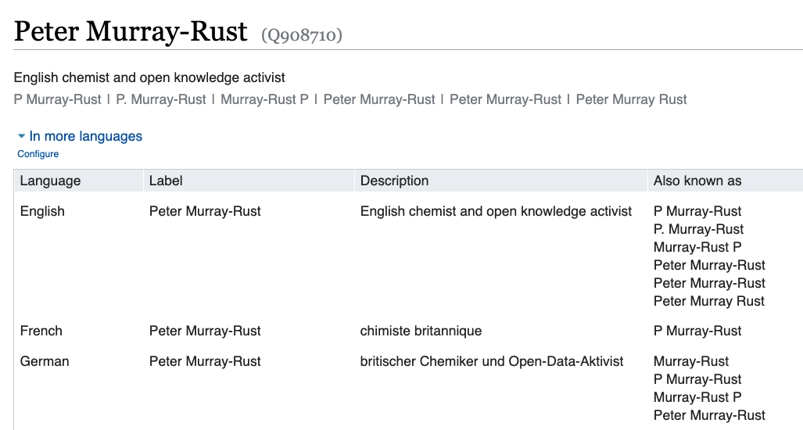

Slide 7
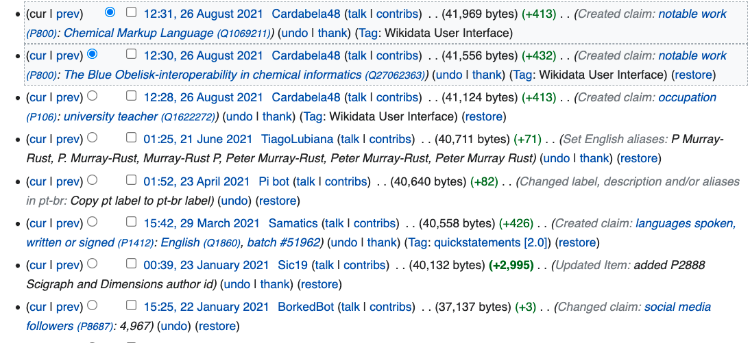
Wikidata is regularly updated, by volunteers

Slide 8
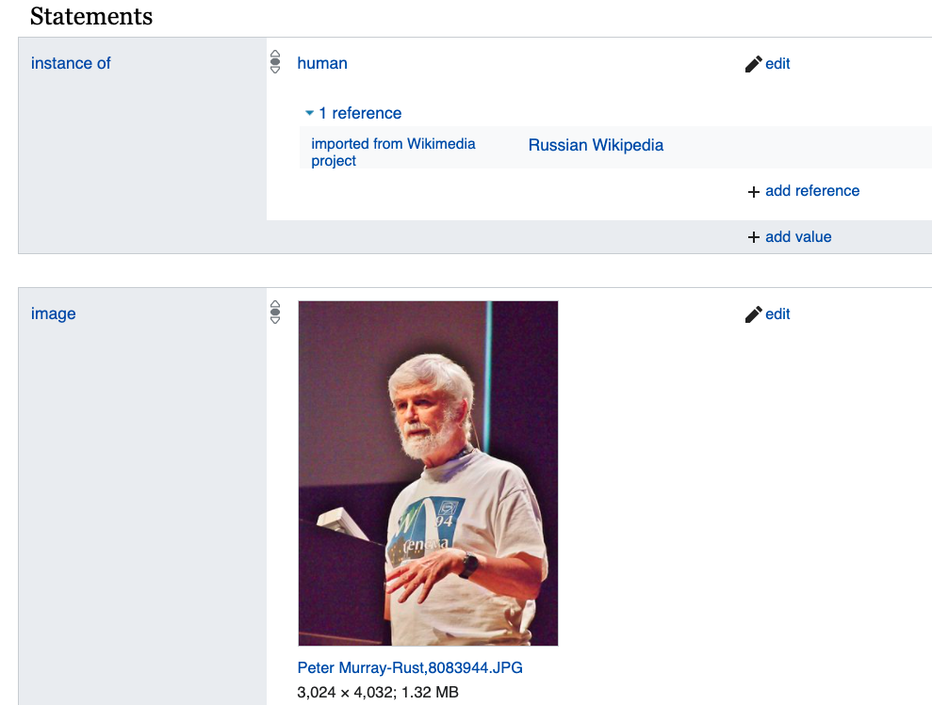
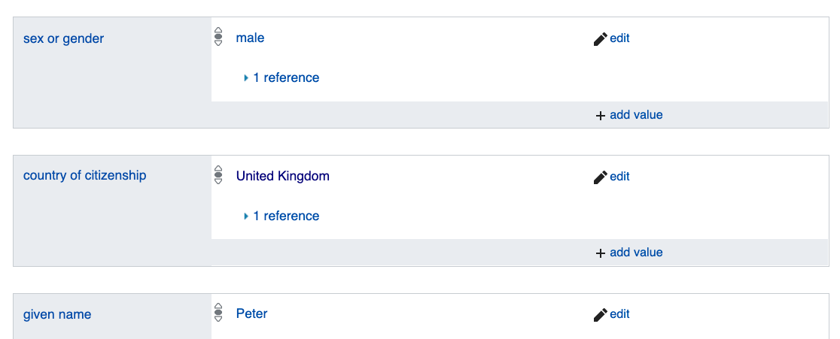

Slide 9
Why is ContentMining important?

Slide 10
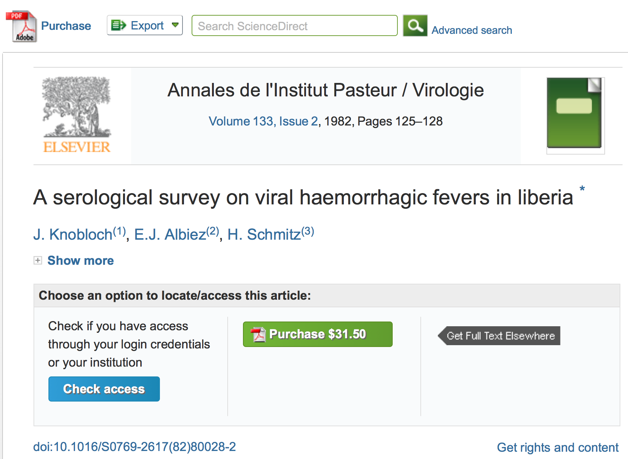
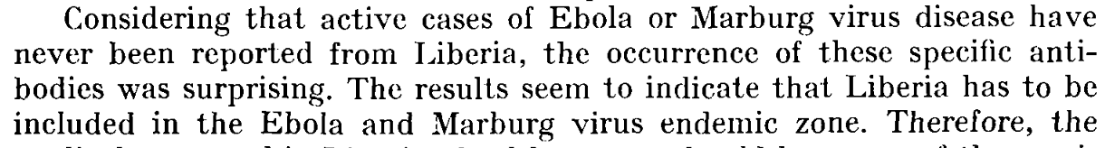

Slide 11
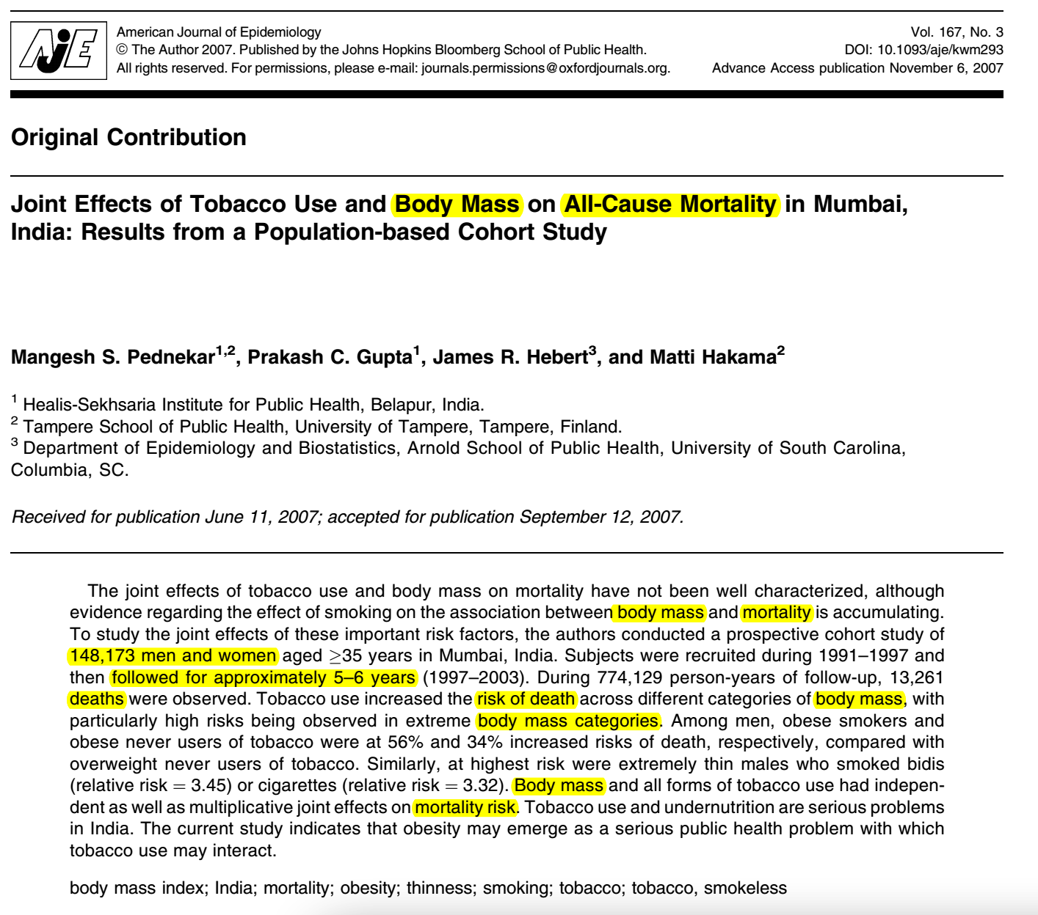
Polly has 20 seconds to read this paper…
Systematic Reviews
…and 10,000 more

Slide 12
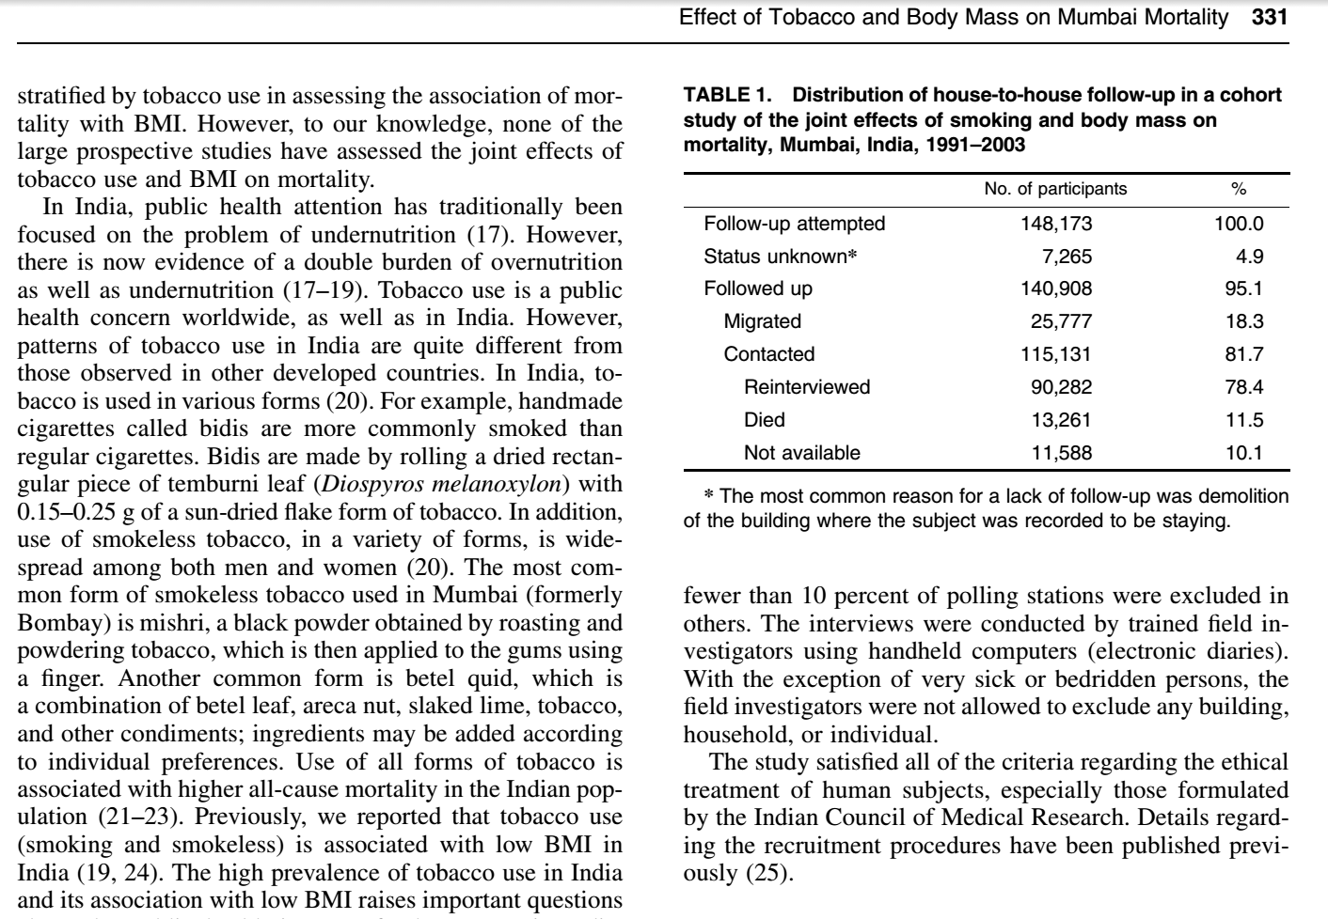
Polly: “there were 10,000 abstracts and due
to time pressures, we split this between 6 researchers. It took about 2-3 days of work (working only on this) to get through
~1,600 papers each. So, at a minimum this
equates to 12 days of full-time work (and would normally be done over several weeks under normal time pressures).”
ContentMine software can do this in a few minutes

Slide 13
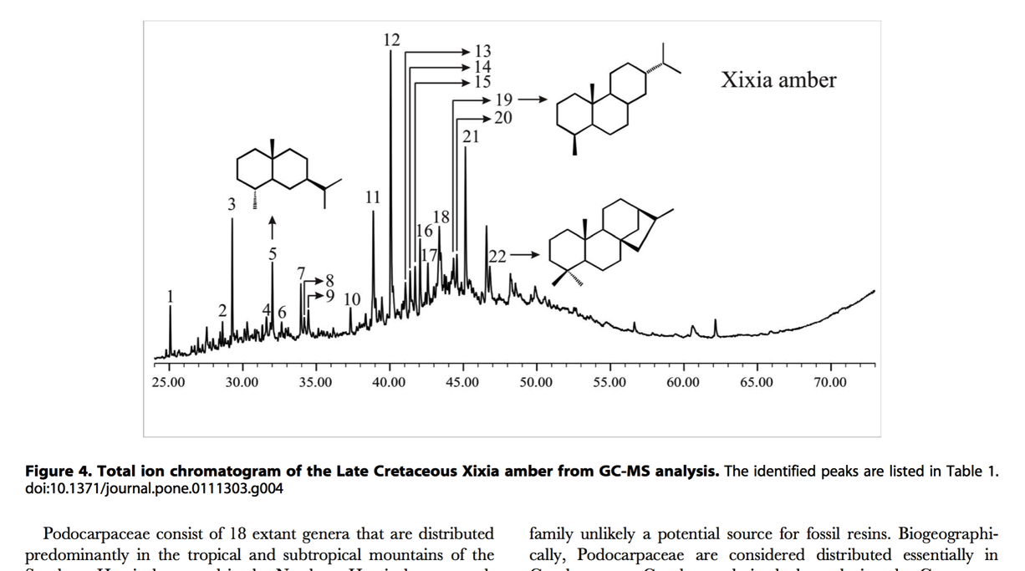
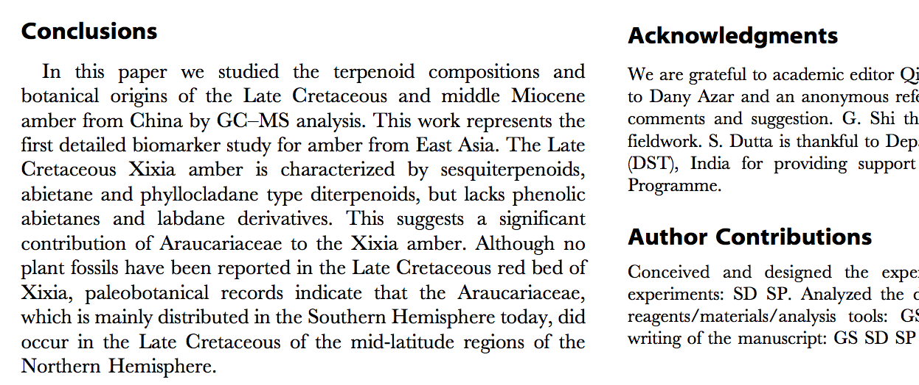
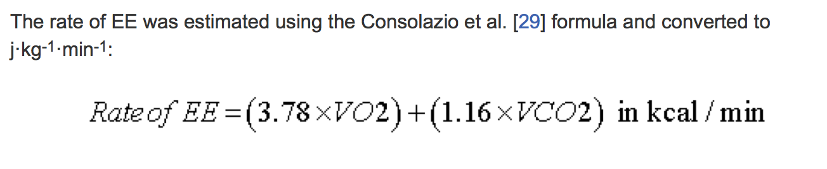
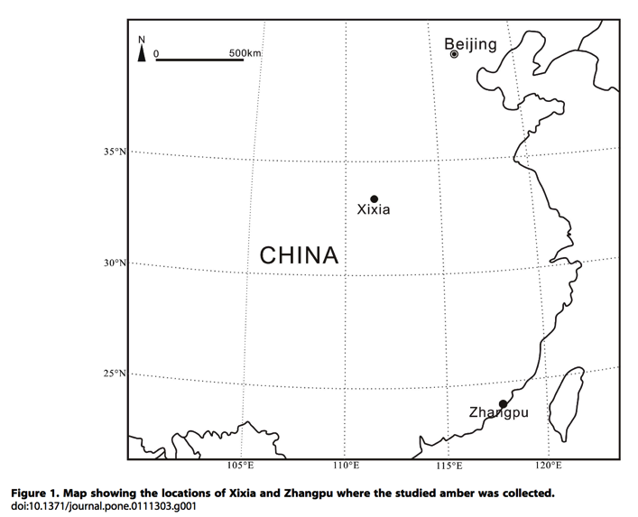
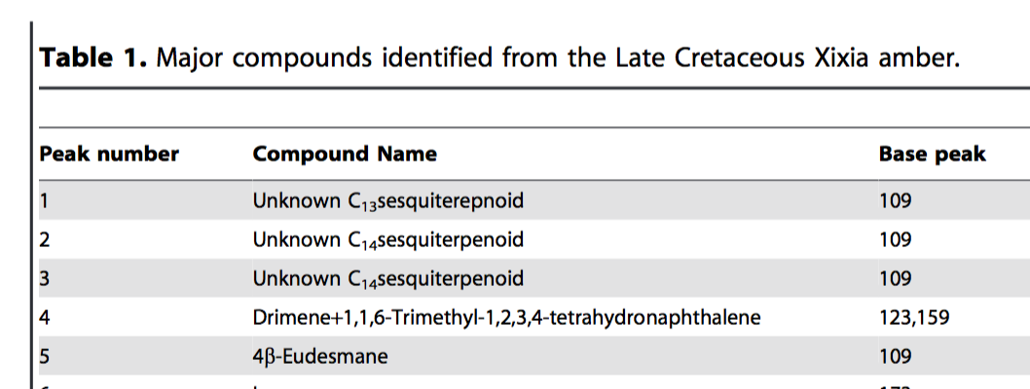
What is “Content”?
TEXT
CHEMISTRY
MATH
SECTIONS
contentmine.org tackles these
TABLES
MAPS
http://www.plosone.org/article/fetchObject.action?uri=info:doi/10.1371/journal.pone.0111303&representation=PDF CC-BY

Slide 14
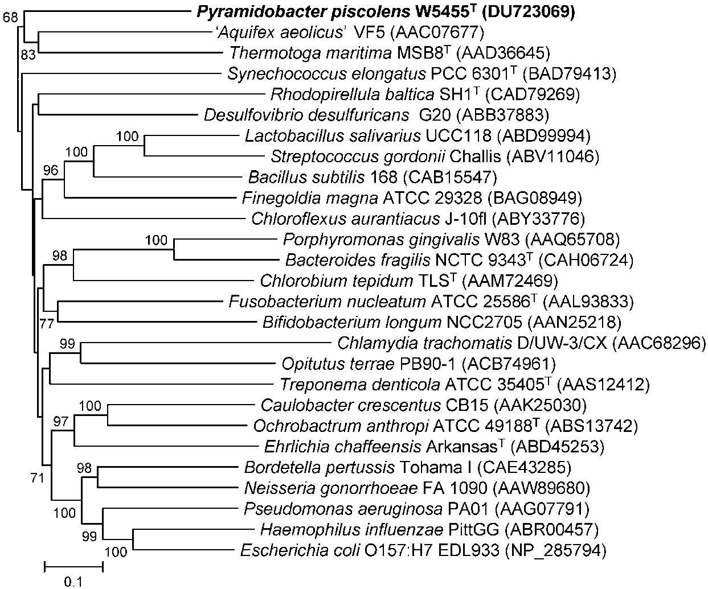
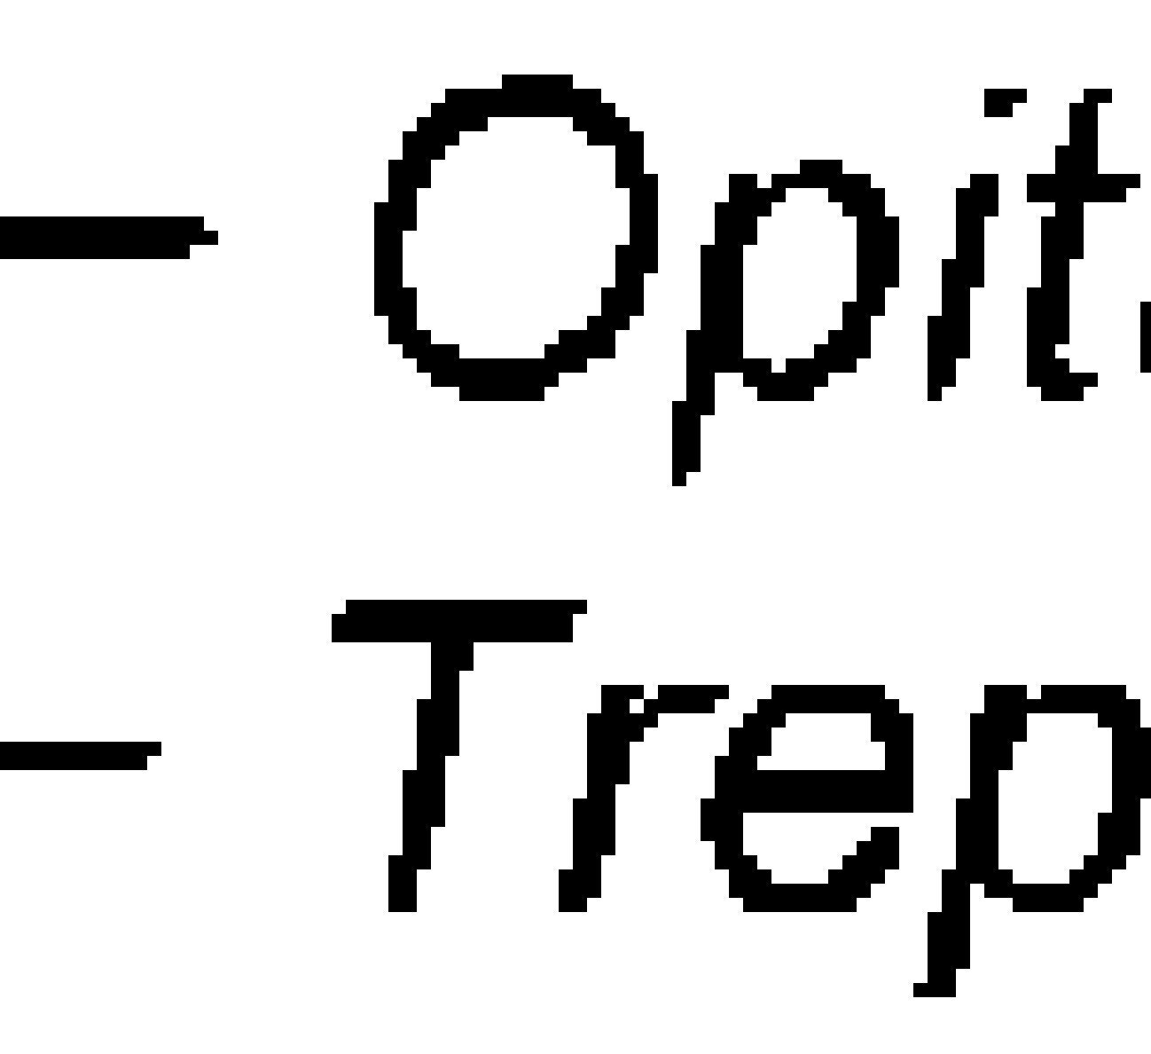
“Root”

Slide 15
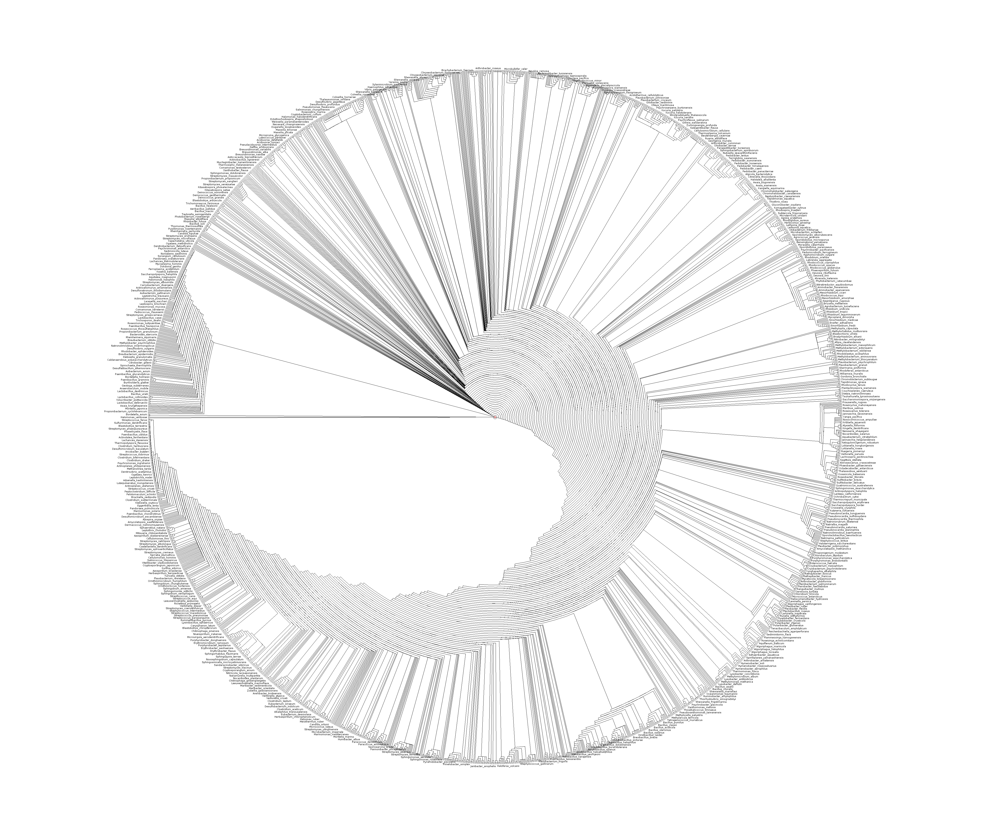
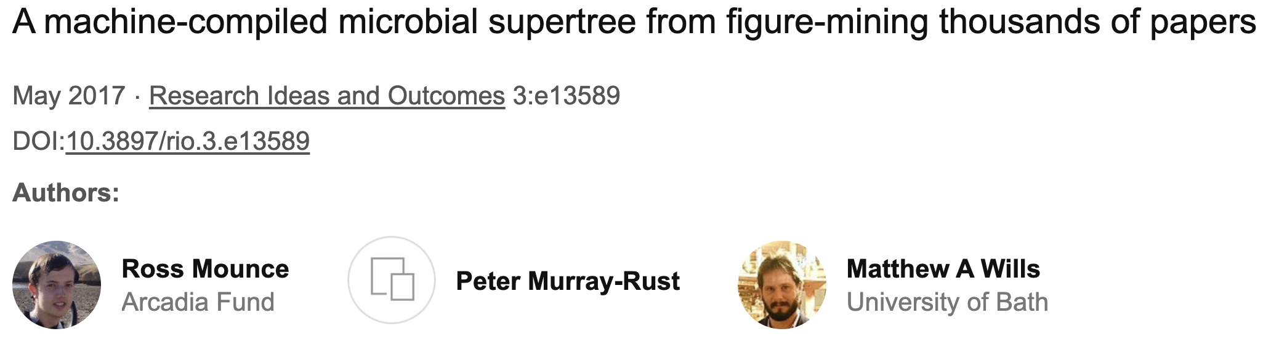
Supertree created from images in 4300 papers
https://riojournal.com/article/13589/zoom/fig/3608052/

Slide 16
Mining in action

Slide 17
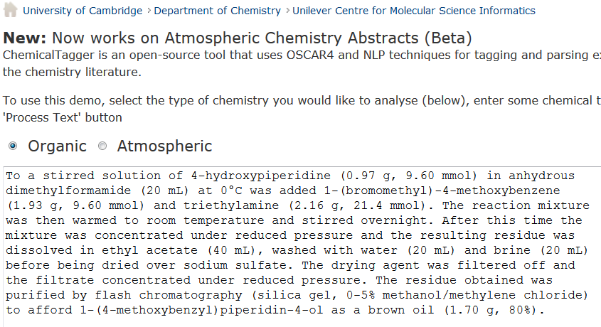
http://chemicaltagger.ch.cam.ac.uk/
Typical
Typical chemical synthesis

Slide 18
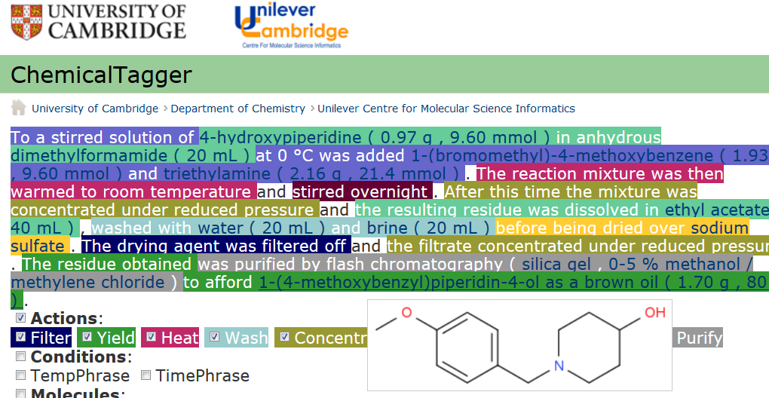
Automatic semantic markup of chemistry
Could be used for analytical, crystallization, etc.

Slide 19
Tools and resources

Slide 20
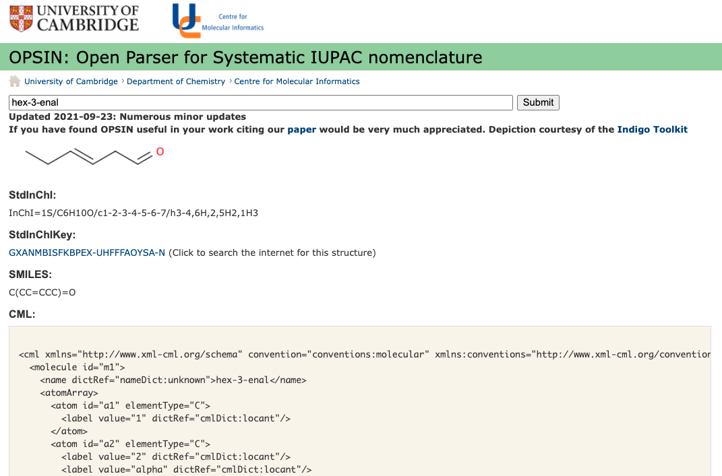
OPSIN: Semantic chemistry
https://opsin.ch.cam.ac.uk/
Daniel Lowe’s chemical name interpreter

Slide 21
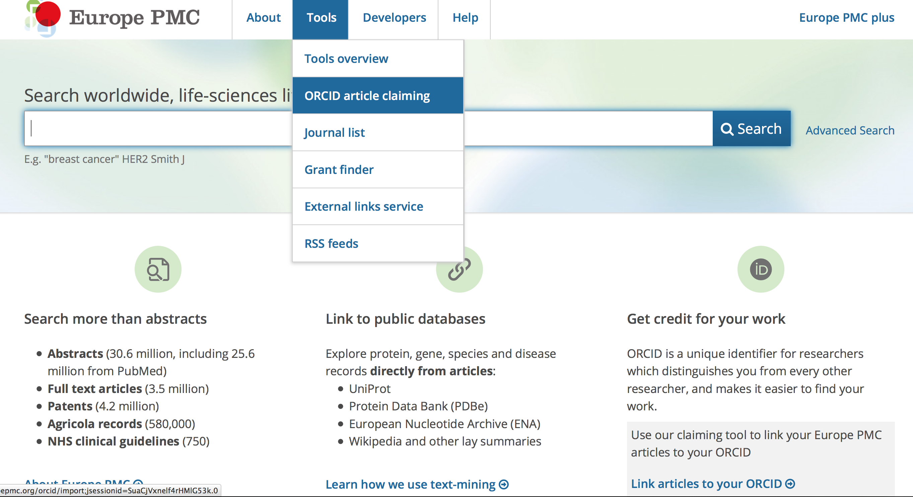
Europe PubMedCentral

Slide 22
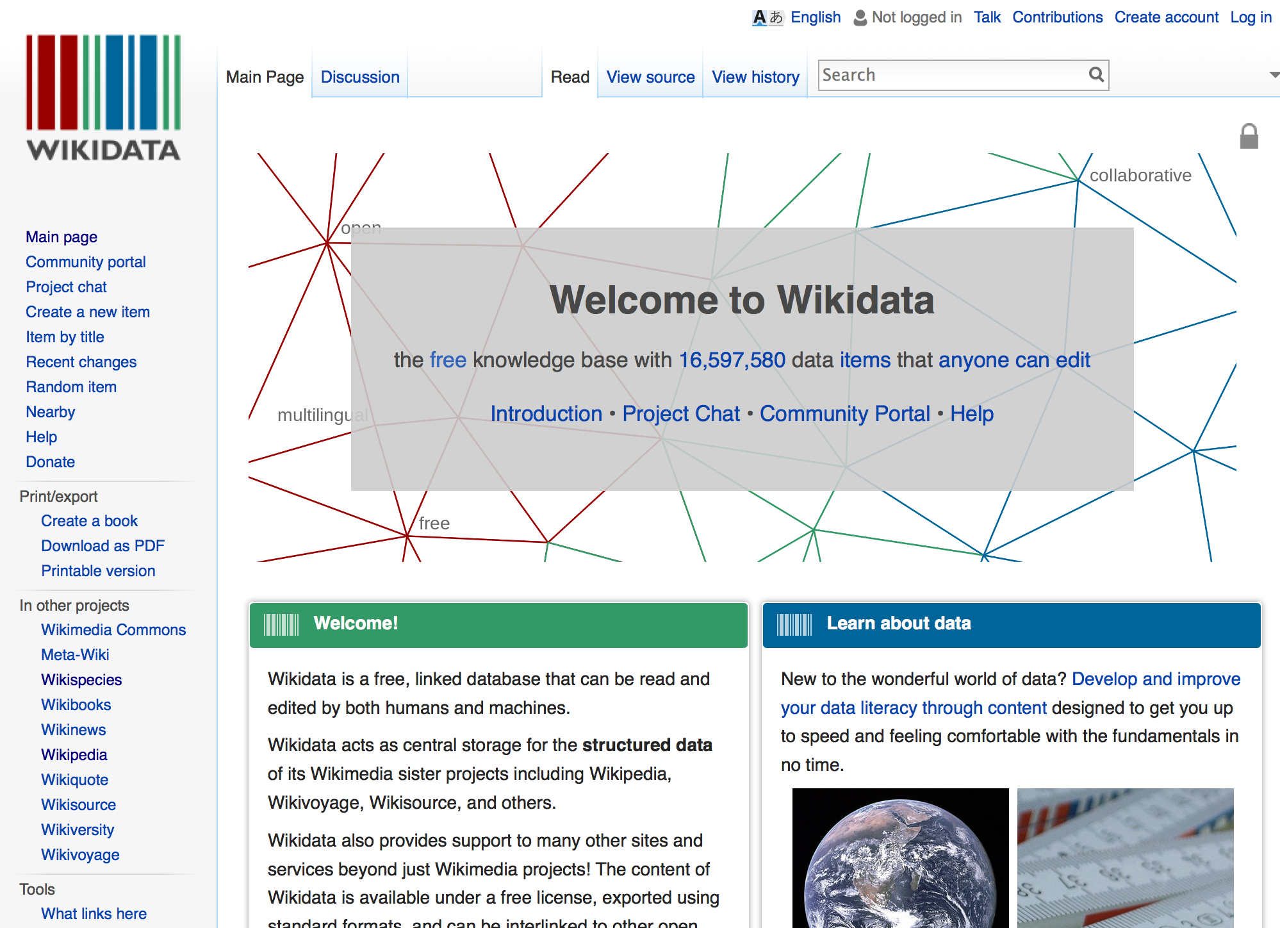
100 million

Slide 23
Workflow
Download Literature
Search literature using dictionaries
Create Dictionaries
Link to Wikimedia
Shweata N Hegde

Slide 24
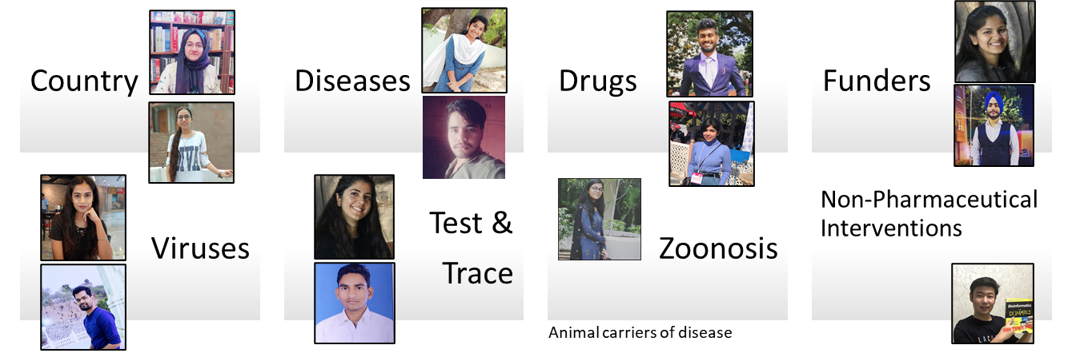



OpenVirus Dictionaries
Multilingual!
Slide Credits: Ambreen Hamadani
Credits: MS PowerPoint 3D Models; Wikipedia (https://en.wikipedia.org)
Notes:
Wikidata and Wikipedia globe
Slide for minicopus
Image of the people involved in each project
Numbers if we do not limit the search
Picture of local machines

Slide 25
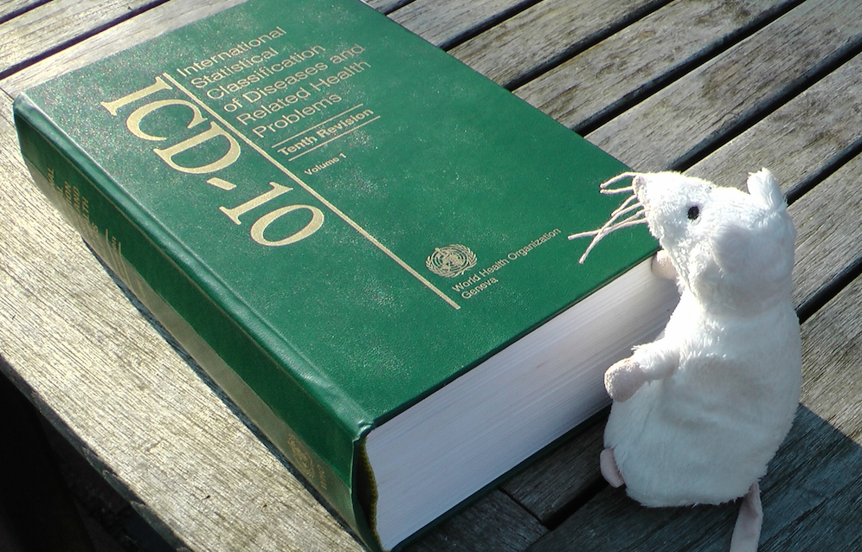
Dictionaries!

Slide 26
Plant Parts Dictionary (CEVOpen)
<entry term="cone“ wikidataURL="http://www.wikidata.org/entity/Q22710" wikidataID="Q22710" wikipediaPage="https://en.wikipedia.org/wiki/Conifer_cone">
<synonym>Cone, Conifer cones, Strobilus, pine cone, pine-cone, pinecone, pine cones</synonym>
<synonym xml:lang="zh">松球</synonym>
<synonym xml:lang="de">Koniferenzapfen</synonym>
<synonym xml:lang="hi">कोणधारी कोण</synonym>
<synonym xml:lang="es">cono</synonym>
<synonym xml:lang="fr">cône</synonym>
<description xml:lang="fr">organe reproducteur des conifères</description>
<description xml:lang="es">estructura vegetal</description>
</entry>
term
Multilingual entries
Credits: Vasant Kumar

Slide 27
Presentations from Video
Shweata Hegde (0:00 – 8:00) Prachi Singh (8:00 – 11:00) Anam Anjum Anjali Shekhawat Rageshwari Singh (15:00 - 19:00) Shweata Hegde (19:00 – 21:00)
Also Thanks to Sagar Jadhav

Slide 28
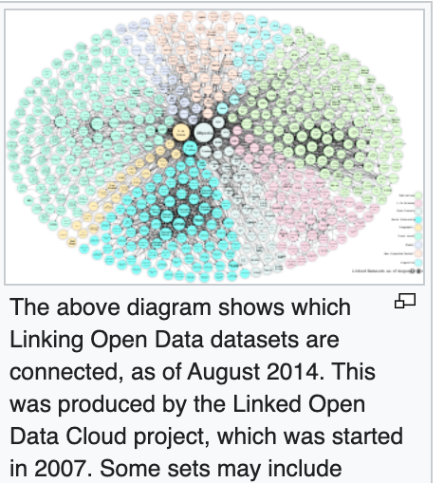
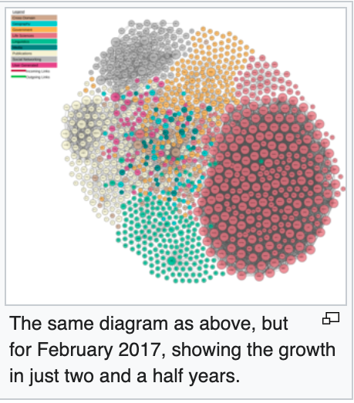
Many of these datasets acts as dictionaries of common scientific objects
https://en.wikipedia.org/wiki/Linked_data

Slide 29
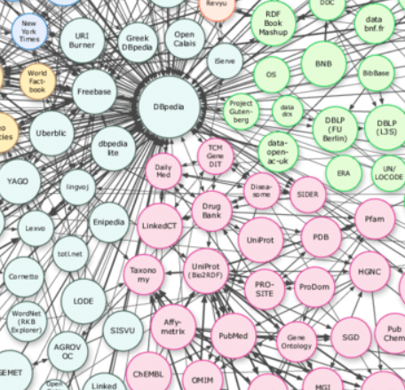
DBpedia 2007
Collection of
links in Wikipedia
DBpedia
Drugbank
UniProt
PDB
Gene
Ontology
PubChem
ChEMBL

Slide 30
Linked OpenData cloud

Slide 31
Linked OpenData
100 million items
Dictionaries
Documents

Slide 32
Workflow
Download Literature
Search literature using dictionaries
Create Dictionaries
Link to Wikimedia
Shweata N Hegde

Slide 33
Ayush

Slide 34
Workflow
Download Literature
Search literature using dictionaries
Create Dictionaries
Link to Wikimedia
Shweata N Hegde

Slide 35
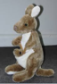
abstract
Captioned
Figures
methods
Fig. 1
MINING
with sections
and dictionaries
HTML tables
references
abstract
Captioned
Figures
Dict A
Fig. 1
Image
Caption
methods
HTML tables
Dict B
references
Table
Caption
[W3C Annotation / https://hypothes.is/ ]

Slide 36
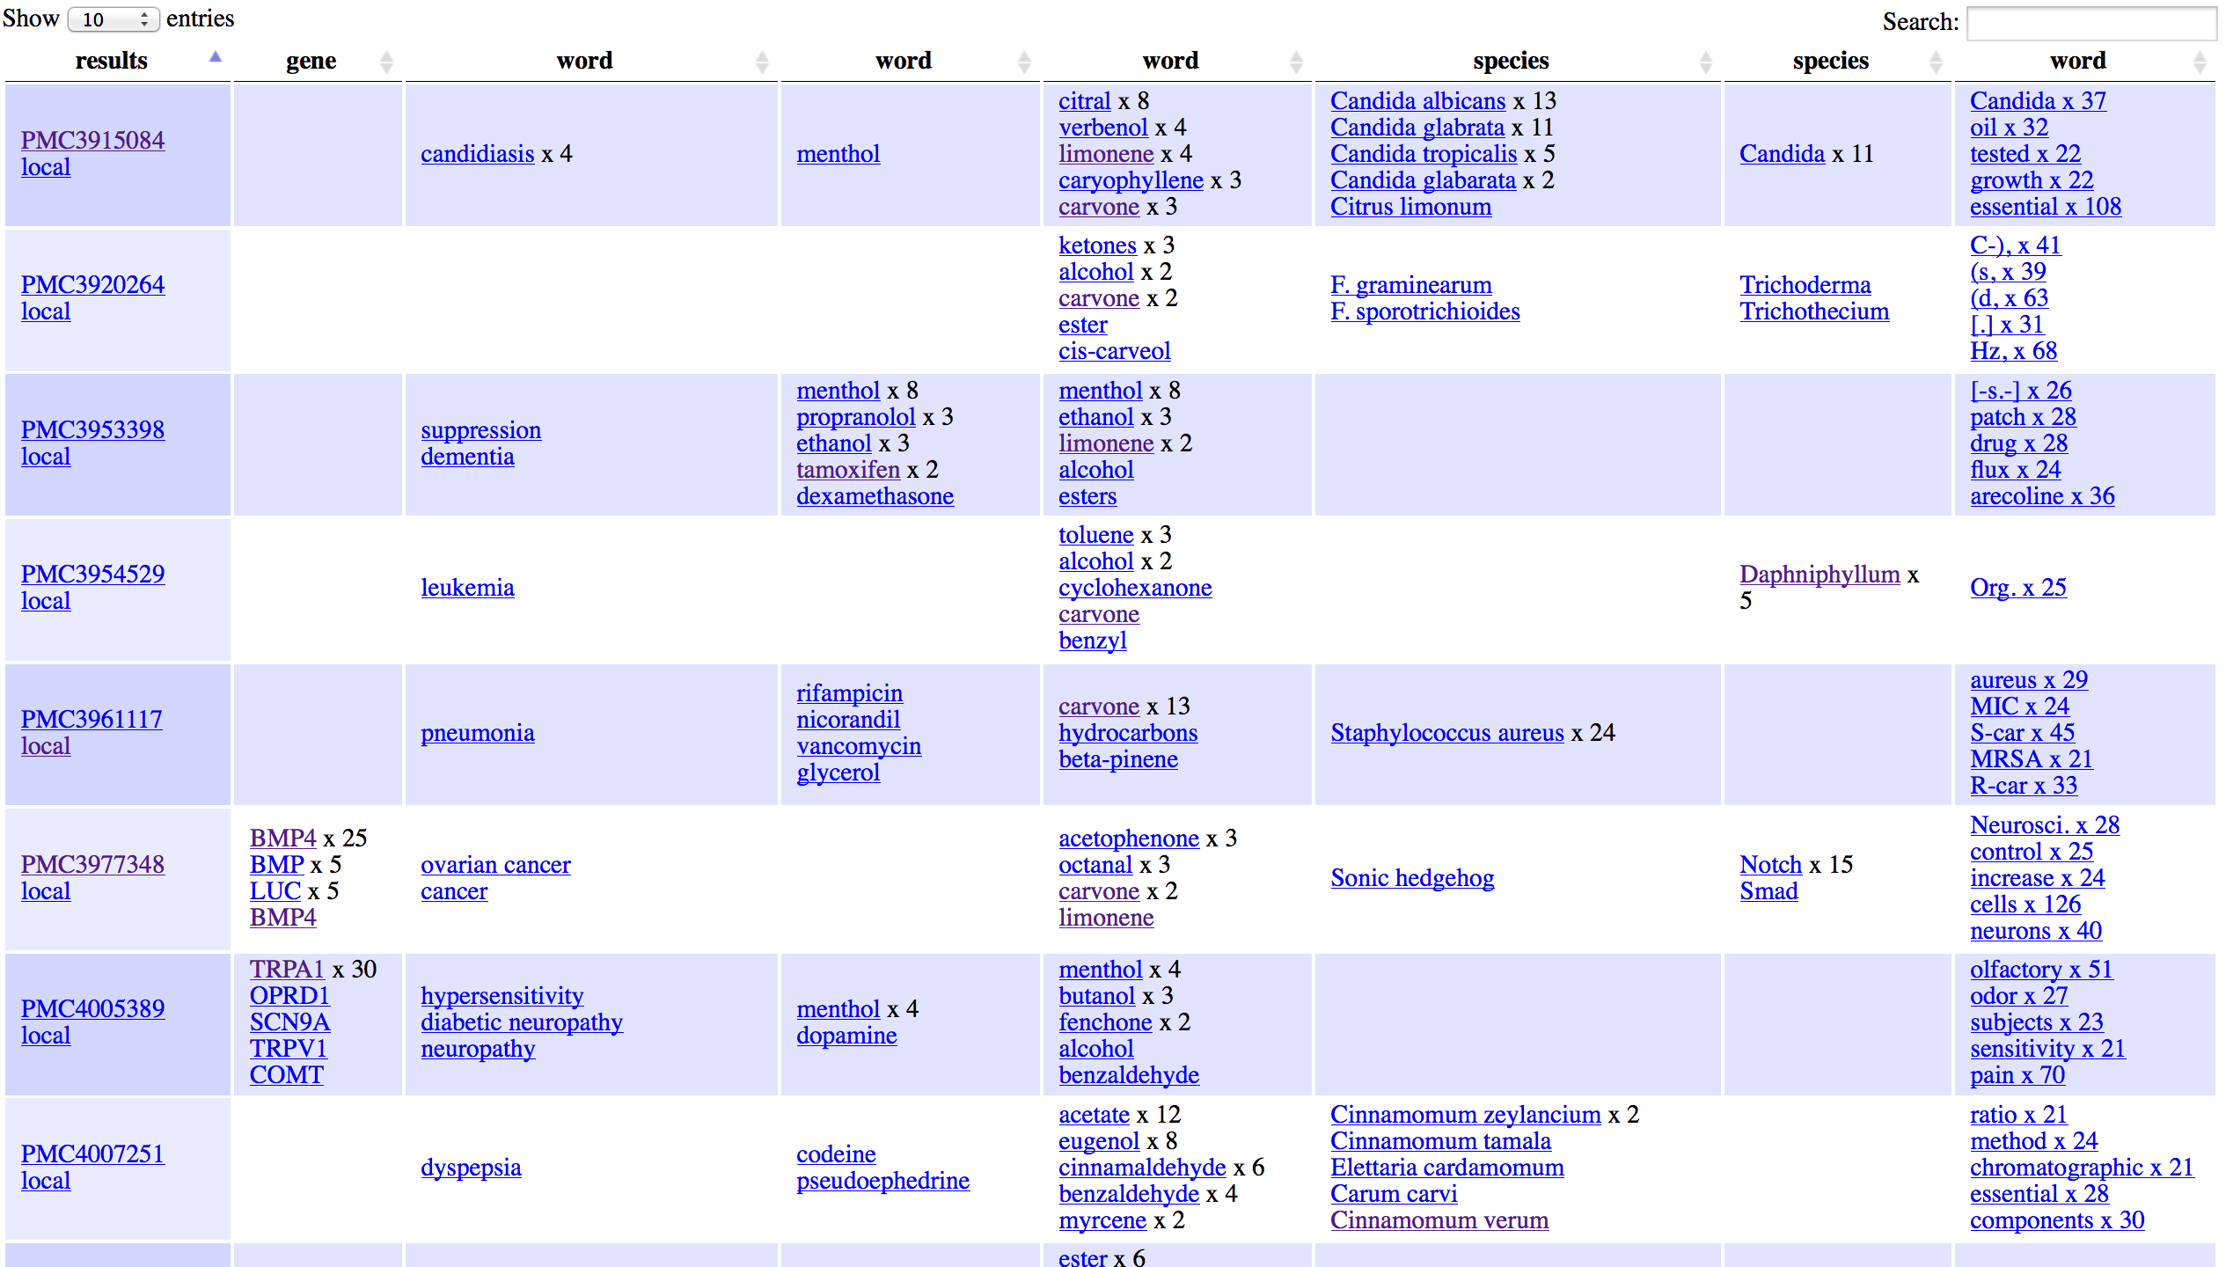
ARTICLES
FACETS
gene
disease
drug
Phyto
chem
species
genus
words

Slide 37
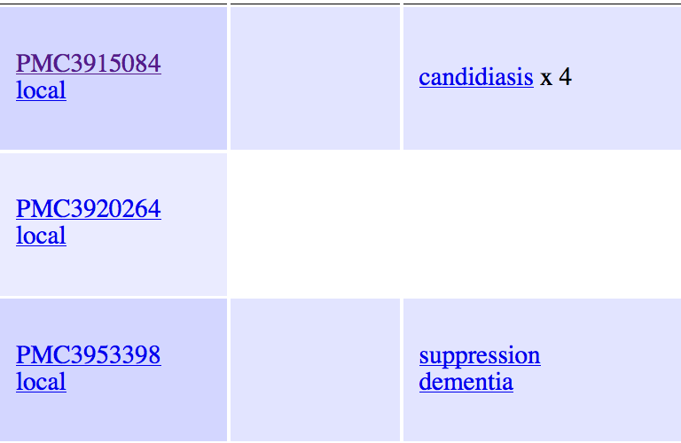
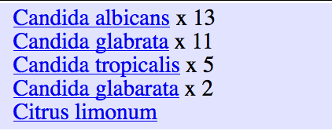
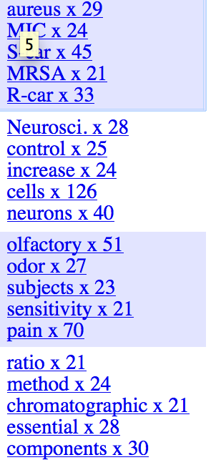
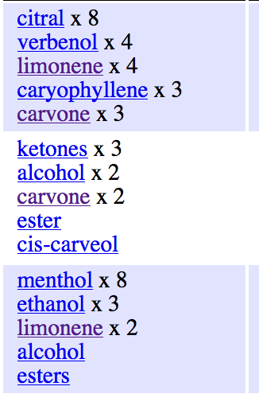
Remote &
Local papers
Disease
ICD-10
species
Commonest
words
phytochemicals

Slide 38
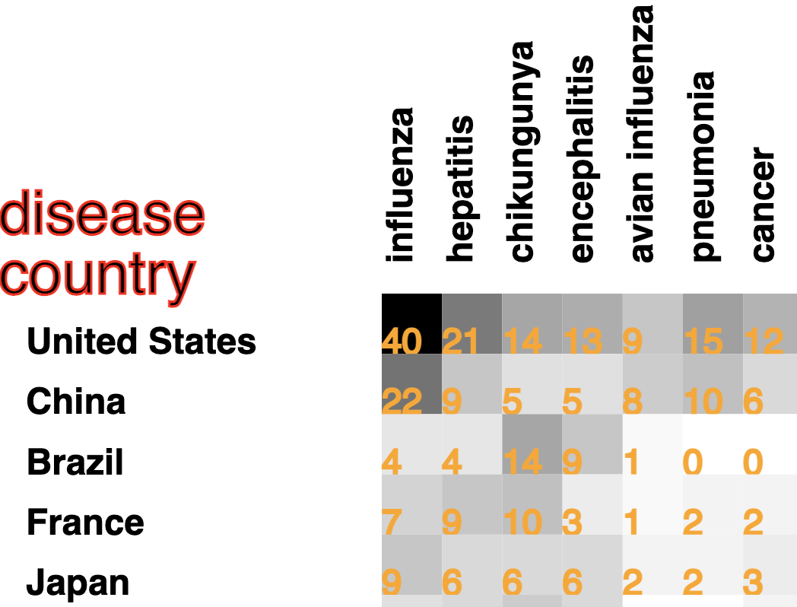
Co-occurrence in documents
Now developing this within sentences

Slide 39
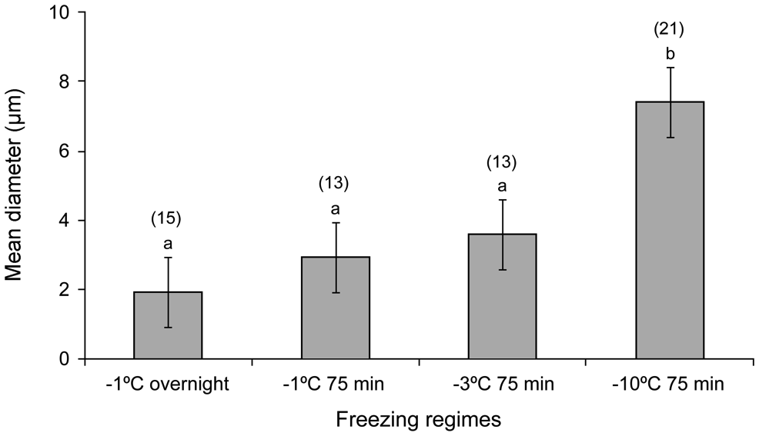
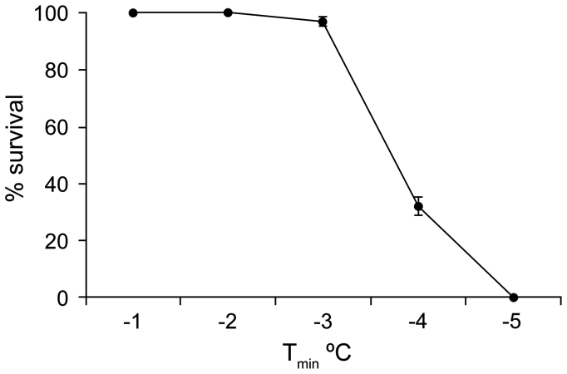
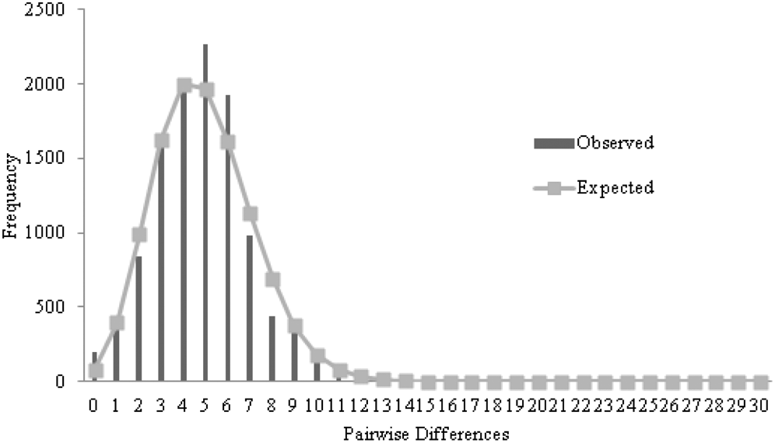
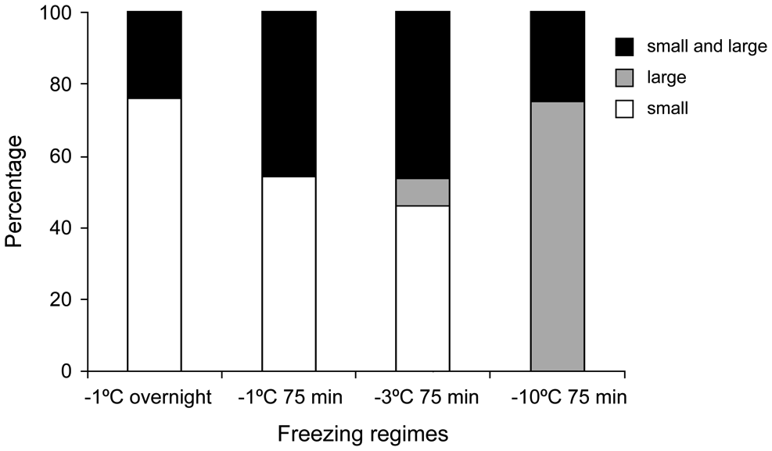
Examples of plots

Slide 40
“Root”

Slide 41
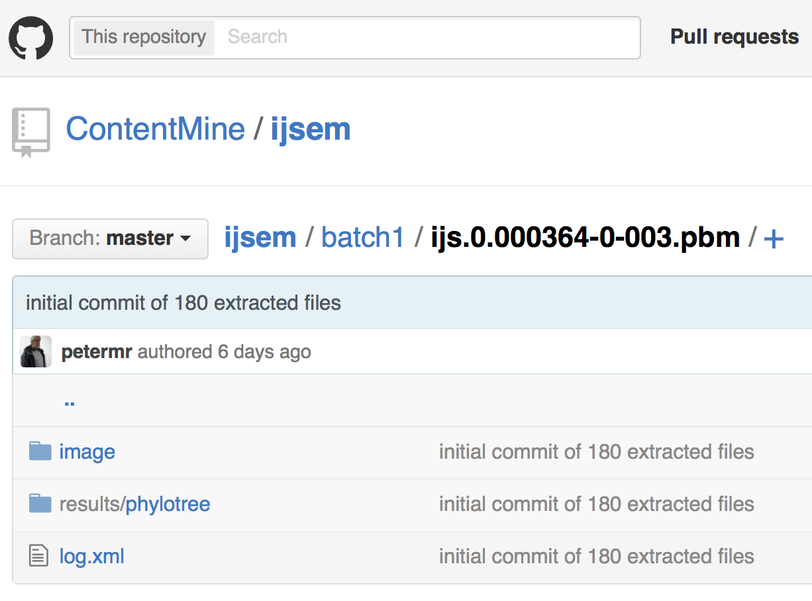
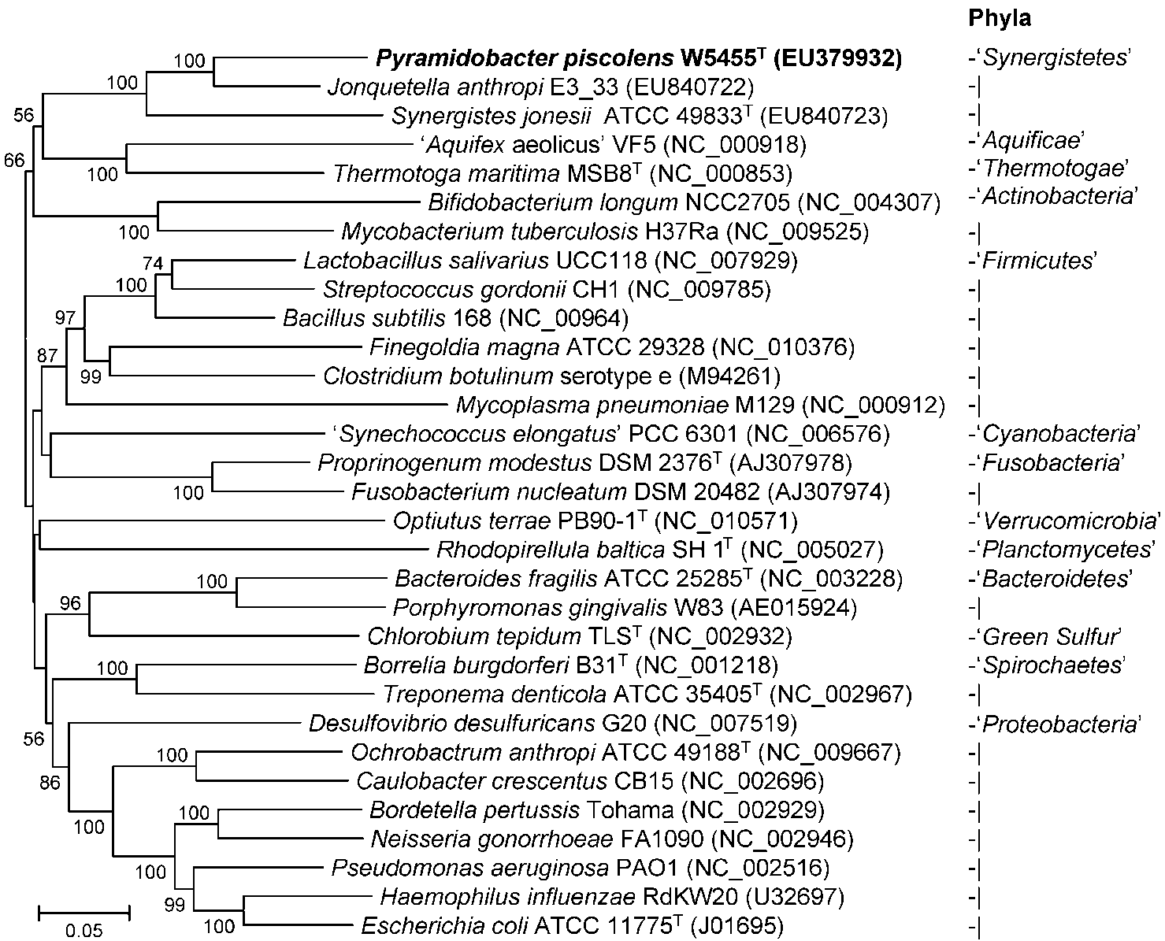
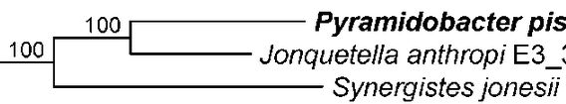
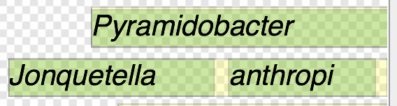
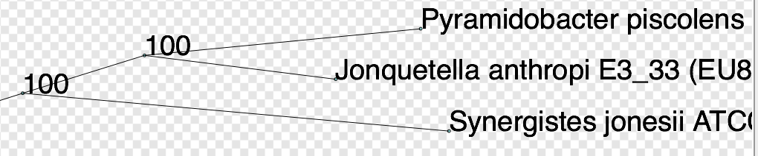
OCR (Tesseract)
Norma (imageanalysis)
(((((Pyramidobacter_piscolens:195,Jonquetella_anthropi:135):86,Synergistes_jonesii:301):131,Thermotoga_maritime:357):12,(Mycobacterium_tuberculosis:223,Bifidobacterium_longum:333):158):10,((Optiutus_terrae:441,(((Borrelia_burgdorferi:…202):91):22):32,(Proprinogenum_modestus:124,Fusobacterium_nucleatum:167):217):11):9);
Semantic re-usable/computable output (ca 4 secs/image)

Slide 42
Supertree created from 4300 papers

Slide 43
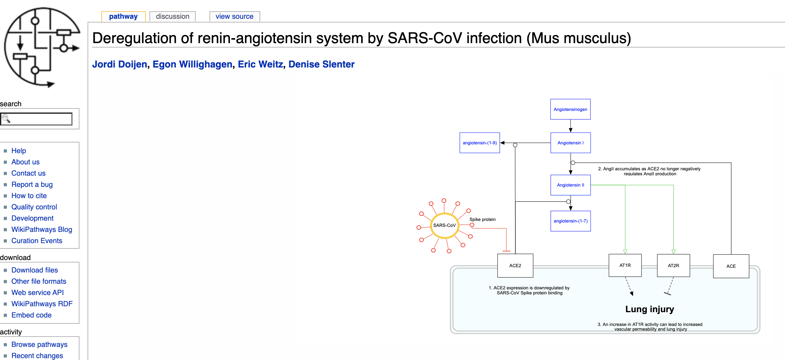
Anuv Chakraborty
Extraction of Biological pathways
Typical Wikipathway

Slide 44
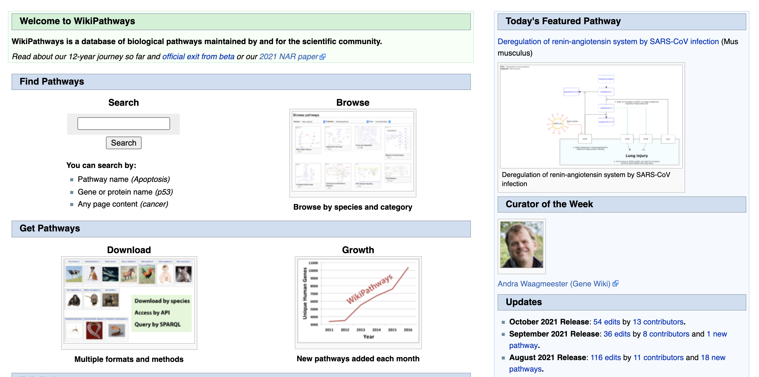
We can offer results to Wikipathways
https://www.wikipathways.org/index.php/WikiPathways

Slide 45
Thanks:
NIPGR, Delhi for 11 interns
INYAS 5 interns
KARYA 4 interns
Wikimedia grant to ContentMine
https://github.com/petermr/openVirus viral epidemics
https://github.com/petermr/CEVOpen plant science
https://github.com/petermr/ami3 AMI Semantic framework
https://github.com/petermr/pyami Python AMI Semantic framework
https://github.com/petermr/pyamiimage Python Image mining
https://slideshare.com/petermurrayrust. Many talks

Slide 46
Future directions
Extensible:
Dictionaries
Repositories
Software
Language
Diagram type
Volunteers and partners welcome

